Slide 1


STANLEY COLLEGE OF ENGINEERING AND TECHNOLOGY FOR WOMEN
TEXT TO VIDEO CONVERTER USING AI
TEAM NAME :TECH_GIRLS
AI HACKDAY 2025
22nd FEB 2025
TEAM MEMBERS:
BANDILA REYA GRACE
ANAJIPURAM SHIVANI
HUSEPWAR AISHWARYA
MENTORS : Dr.SWAPNA
Mrs.GNANA PRASUNA

Slide 2

PROBLEM STATEMENT:
Design a content generator that automatically converts educational books, articles, or research papers into narrated video summaries in local languages.
PROJECT OBJECTIVE:
The project objective is to develop an automated system that transforms educational content into narrated video summaries in local languages, enhancing accessibility and understanding for diverse linguistic communities.
SCOPE OF THE PROJECT:
The project will develop an automated system to transform educational materials into narrated video summaries in local languages, focusing on content analysis, accurate translation, engaging narration, and video creation. It will cover a variety of educational content, prioritize major local languages, maintain concise summaries, adhere to technical constraints, and ensure continuous improvement through user feedback.

Slide 3

HOW IS OUR PROJECT INNOVATIVE ?
Our project is innovative because it automates the conversion of educational materials into narrated video summaries, making content more engaging and accessible. It uses advanced technology to analyze and summarize text-based content, creating simple, easy-to-understand videos that cater to diverse learners' needs and preferences.
WHAT DRIVES OUR INSPIRATION AND MOTIVATION BEHIND THIS ENDEAVOR?
By leveraging innovative technology, we aim to bridge the gap between information and understanding, making education a universal right.
Highlight Features
AI-Powered Content Transformation
Multi-Language Support
High-Quality Narration
Concise Summaries
User-Friendly Interface

Slide 4

Technologies, Frameworks, and Tools Used:
Python - Programming language used for scripting and automation.
Stable Diffusion - AI model for generating images.
Google Text-to-Speech (gTTS) - Converts text to speech.
MoviePy - Video editing and production library.
Torch - For running machine learning models on CPU/GPU.
System Architecture
User Interface:
Accepts input (story text) from the user.
Displays the final narrated video.
Content Processing Module:
Text Analysis: Breaks down the input story into segments.
AI Image Generation: Uses Stable Diffusion to create images for each segment.
Text-to-Speech Conversion: Converts story segments into speech using gTTS.
Audio-Visual Integration:
Audio Synchronization: Combines narration with background music.
Video Creation: Merges images, text animations, and synchronized audio.
Output Module:
Video Export: Finalizes and exports the video.

Slide 5

Algorithm Overview
Content Analysis
AI Image Generation
Text-to-Speech Conversion
Audio-Visual Integration
Video Creation
Challenges and Solutions
Accurate Content Extraction
High-Quality Translation
Natural-Sounding Narration
Seamless Audio-Visual Integration
Technical Constraints
Code Highlights
Content Analysis and Extraction
Generate AI Images
Convert Story to Speech
Combine Audio Files
Add Background Music
Create Video Clips with Text Animations
Merge Everything into Final Video

Slide 6


Real World Problem Solved
- Language barriers in accessing educational content.
- Difficulty in understanding complex academic material.
- Limited availability of localized educational resources.
Practical Application
- Automated conversion of educational materials into narrated video summaries.
- Multi-language support for wider accessibility.
- Enhanced learning experience through visual and audio content.
Feasibility
- Utilizes existing AI technologies like text-to-speech, image generation, and video editing.
- Scalable system for additional languages and content types.
- Requires initial investment in development and infrastructure.
User or Market Impact
- Increases accessibility to education for non-native speakers and those with reading difficulties.
- Provides a more engaging and effective learning tool for students and educators.
- Revolutionizes the consumption of educational content, promoting inclusivity.

Slide 7

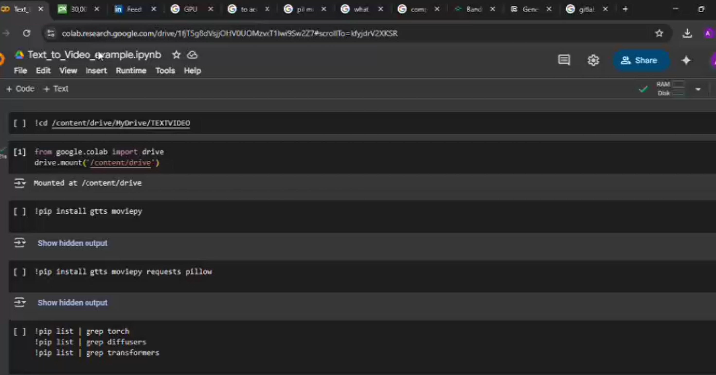
PROJECT DEMO

Slide 8

1. Limitations
- Limited initial language support.
- Dependency on the quality of AI-generated images and speech synthesis.
- Technical constraints related to processing power and storage.
2. Improvements
- Expand language support to include more regional languages.
- Enhance AI algorithms for better image generation and natural-sounding speech.
- Incorporate advanced NLP techniques for more accurate content extraction.
- Implement user feedback loops for continuous enhancement.
3. Long Term Vision
- Develop a fully scalable platform that supports a wide range of educational content and languages.
- Integrate interactive elements to create immersive learning experiences.
- Leverage emerging technologies to stay at the forefront of AI-driven educational tools.
- Foster partnerships with educational institutions to democratize access to high-quality education globally.

Slide 9
